Slide 1
A Peek at the Budget
Bill of Materials

Slide 2
Bill of Materials
Item | Stock | Price Per Unit | Total Price
20 Tooth Gear | 2 | $16.04 | $32.08
50 Tooth Gear | 2 | $21.99 | $43.98
Stainless Steel Ball Bearing | 6 | $7.00 | $42.00
Ball Bearing | 1 | $5.79 | $5.79
Set Screw Shaft Collar | 6 | $0.99 | $5.94
High Strength Steel Threaded Rod | 1 | $6.88 | $6.88
High Strength Steel Flange Nuts | 1(100) | $6.52 | $6.52
Total Price of Materials for Project comes out to $143.19

Slide 3
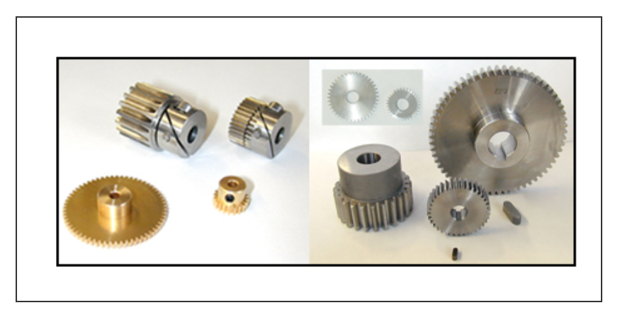
The Gears
20 Tooth Gear
48 Pitch Diameter
20 Degree Pressure Angle
20 Teeth
50 Tooth Gear
48 Pitch Diameter
20 Degree Pressure Angle
50 Teeth

Slide 4
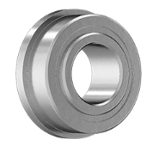
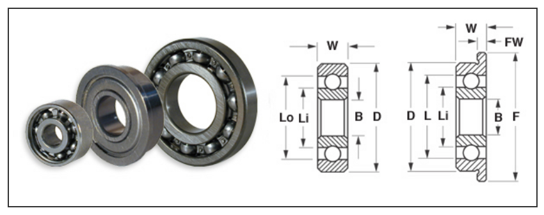
The Bearings
Stainless Ball Bearing
For a 0.25” shaft & a 0.5” housing
0.1875” width
240lb dynamic load and 90lb static load
Flanged
0.547” diameter, 0.05” width
Ball Bearing
For a 0.25” shaft and a 0.5” housing
0.188” width
123lb dynamic load and 54lb static load
Not Flanged

Slide 5
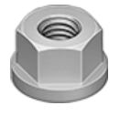
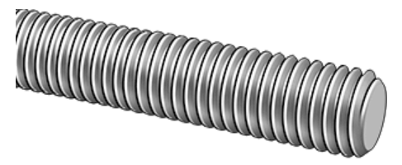
Rods and Nuts
High Strength Steel Flanged Nuts
Come in Pack of 100
0.4375” width
0.59375” flange diameter
0.04” flange width
High Strength Steel Threaded Rod
Tensile Strength of 115 lbs
0.25”-20 Thread Size
1 ft long

